Slide 1
Unit 3—Lesson 1:
Optionals
Notes:
Say
Remember that safety is one of the big goals of Swift.
Bugs are commonly created when you’re referencing "not having" something.
Swift has an interesting solution.

Slide 2
nil
struct Book {
let name: String
let publicationYear: Int
}
let firstHarryPotter = Book(name: "Harry Potter and the Sorcerer's Stone", publicationYear: 1997)
let secondHarryPotter = Book(name: "Harry Potter and the Chamber of Secrets", publicationYear: 1998)
let books = [firstHarryPotter, secondHarryPotter]
Notes:
Say
This slide shows a Book struct with name and publicationYear properties.

Slide 3
nil
let unannouncedBook = Book(name: "Rebels and Lions",
publicationYear: ???)
Notes:
Say
What if we want to represent a book that hasn't been published yet?

Slide 4
nil
let unannouncedBook = Book(name: "Rebels and Lions",
publicationYear: 0)
Notes:
Say
Zero isn't accurate, because that would mean the book is over 2,000 years old.

Slide 5
nil
let unannouncedBook = Book(name: "Rebels and Lions",
publicationYear: 2027)
Notes:
Say
The current year isn't accurate either, because it may be released the next year. There's no known launch date.

Slide 6
nil
let unannouncedBook = Book(name: "Rebels and Lions",
publicationYear: nil)
!
Nil is not compatible with expected argument type ‘Int’
Notes:
Say
nil represents the absence of a value, or nothing. Because there is no publicationYear value yet, publicationYear should be nil.
That looks better, but the compiler throws an error.
Do
Click to display the error.
Say
All instance properties must be set during initialization, and you can't pass nil to the publicationYear parameter because it expects an Int value.

Slide 7
struct Book {
let name: String
let publicationYear: Int?
}
let firstHarryPotter = Book(name: "Harry Potter and the Sorcerer's Stone",
publicationYear: 1997)
let secondHarryPotter = Book(name: "Harry Potter and the Chamber of Secrets", publicationYear: 1998)
let books = [firstHarryPotter, secondHarryPotter]
let unannouncedBook = Book(name: "Rebels and Lions", publicationYear: nil)
Notes:
Say
This slide shows let publicationYear: Int? and shows that nil will now work.
publicationYear may have a value or may be nil, which means "no value," not zero.
Anything can be optional—string, struct, and so on.

Slide 8
Specifying the type of an optional
var serverResponseCode = 404
var serverResponseCode: Int? = 404 var serverResponseCode: Int? = nil
!
var serverResponseCode = nil
‘nil’ requires a contextual type
Notes:
Do and Say
Click to display the first line. This defines a regular Int.
Click to display the second line. This generates an error.
Click to display the error. What type is it supposed to be? Int optional, String Optional, or other?
Click to display the two ways to define an optional.
var serverResponseCode: Int? = 404
This means it's 404 now, but it might be no value at some point.
var serverResponseCode: Int? = nil
This means no value now, but it might be an Int at some point.
Note that you can do var someInt: Int? and Swift makes it nil for you.

Slide 9
Working with optional values
Force-unwrap
if publicationYear != nil {
let actualYear = publicationYear!
print(actualYear)
}
let unwrappedYear = publicationYear!
!
error: Execution was interrupted
Notes:
Say
We're going to see several ways to safely deal with optionals.
One way to test an optional is to compare it to nil.
Describe "force unwrap":
"?" means variable may be nil. "!" means the app may crash.
Do
Click to display the error.
Say
If you use force unwrap and the value is nil, your app crashes.
There are very few use cases for this—we’ll see one in iOS.

Slide 10
Working with optional values
Optional binding
if let constantName = someOptional {
//constantName has been safely unwrapped for use within the braces.
}
if let unwrappedPublicationYear = book.publicationYear {
print("The book was published in \(unwrappedPublicationYear)")
}
else {
print("The book does not have an official publication date.")
}
Notes:
Say
Because it's so common to need to work with optionals, Swift has some shortcuts that are simpler than an explicit comparison to nil.
The first code example shows "if let" syntax: "optional binding."
Note that "if var" also works.
The second code example shows an "if let" example using the optional "publicationYear" property on Book from an earlier slide.

Slide 11
Functions and optionals
Return values
let string = "123"
let possibleNumber = Int(string)
let string = "Cynthia"
let possibleNumber = Int(string)
Notes:
Say
Int has an init that takes a String parameter. What should it do if the input doesn't make sense?
This is a great use of optionals—the return type is Int? ("optional int")

Slide 12
Functions and optionals
Defining
func printFullName(firstName: String, middleName: String?, lastName: String)
func textFromURL(url: URL) -> String?
Notes:
Say
The first code example shows how to declare a function with an optional argument.
The second code example shows how to declare a function that returns an optional.

Slide 13

Failable Initializers
Failable initializers in Swift are initializers that can return nil if the initialization process cannot be completed successfully. They are used when there are conditions that might prevent an instance of a class, structure, or enumeration from being created in a valid state.
Syntax: A failable initializer is defined by placing a question mark after the init keyword (init?).
It creates an optional instance of the type it is initializing. The return value is either a fully initialized instance or nil.
struct Toddler {
var birthName: String
var monthsOld: Int
}
Notes:
Say
We saw that init(string) can return nil. That's called a failable initializer—one that can return nil.
Here's a "Toddler" class with an "age" property.

Slide 14
Failable initializers
struct Toddler {
var birthName: String
var monthsOld: Int
init?(birthName: String, monthsOld: Int) {
if monthsOld < 12 || monthsOld > 36 {
return nil
} else {
self.birthName = birthName
self.monthsOld = monthsOld
}
}
}
struct Toddler {
var birthName: String
var monthsOld: Int
init?(birthName: String, monthsOld: Int) {
if birthName.isEmpty {
return nil
} else {
self.birthName = birthName
self.monthsOld = monthsOld
}
}
}
Notes:
Say
Let's say we want Toddler to return nil if someone tries to make an instance that's too old or too young:
init?(name:String, monthsOld:Int)
Note that the syntax is a bit odd here. You return nil, but you don't return the success instance.

Slide 15
Failable initializers
init?(birthName: String, monthsOld: Int) {
if birthName.isEmpty {
return nil
} else if monthsOld < 12 || monthsOld > 36{
return nil
}
else {
self.birthName = birthName
self.monthsOld = monthsOld
}
}
Notes:
Say
Let's say we want Toddler to return nil if someone tries to make an instance that's too old or too young:
init?(name:String, monthsOld:Int)
Note that the syntax is a bit odd here. You return nil, but you don't return the success instance.

Slide 16
Failable initializers
let myToddler = Toddler(birthName: "Todd", monthsOld: 40)
myToddler?.birthName
Returns Optional : It creates an optional instance of the type it is initializing. The return value is either a fully initialized instance or nil.
Notes:
Say
Let's say we want Toddler to return nil if someone tries to make an instance that's too old or too young:
init?(name:String, monthsOld:Int)
Note that the syntax is a bit odd here. You return nil, but you don't return the success instance.

Slide 17
Failable initializers
let possibleToddler = Toddler(birthName: "Joanna", monthsOld: 14)
if let toddler = possibleToddler {
print("\(toddler.birthName) is \(toddler.monthsOld) months old")
} else {
print("The age you specified for the toddler is not between 1 and 3 yrs of age")
}
The return type will be Toddler? so you need to unwrap with if/let (Optional Binding) or something.
Notes:
Say
The return type will be Toddler? so you need to unwrap with if/let or something.

Slide 18
Failable initializers
init! Failable Initializers
Swift also offers a failable initializer that creates an implicitly unwrapped optional instance, denoted by init!.
This can be used when the failure condition is highly unlikely, but if it occurs, it will cause a runtime crash.
This is often used for interoperability with some Objective-C frameworks where Swift doesn't know if the initializer can return nil.
In most pure Swift code, init? is preferred.
Notes:
Say
The return type will be Toddler? so you need to unwrap with if/let or something.

Slide 19
Optional chaining
Optional chaining is a safe and concise way in Swift to query and call properties, methods, and subscripts on an optional value that might be nil.
It allows you to access members without the risk of a runtime error if the optional value is empty.
Optional chaining uses a question mark (?) after an optional value. If the value is present, the operation continues; if it's nil, the chain returns nil.
This prevents runtime errors and the result is always an optional.
Multiple queries can be chained together, and the entire chain fails gracefully if any link in the chain is nil.
Notes:
Say
The setup shows three structures (“structs”) with optional properties.
Note that a Person can have a Residence, which can have an Address (Person > Residence > Address).

Slide 20
Optional chaining
struct Person {
var age: Int
var residence: Residence?
}
struct Residence {
var address: Address?
}
struct Address {
var buildingNumber: String?
var streetName: String?
var apartmentNumber: String?
}
// --- Scenario 1: Missing Data ---
let personA = Person(age: 25, residence: nil)
// The chain stops at 'residence' because it is nil
let numberA = personA.residence?.address?.buildingNumber
// --- Scenario 2: Complete Data ---
let address = Address(buildingNumber: "101", streetName: "Infinite Loop", apartmentNumber: "4B")
let residence = Residence(address: address)
let personB = Person(age: 30, residence: residence)
// The chain succeeds through every level
let numberB = personB.residence?.address?.buildingNumber
// --- Printing Results ---
print("Result A: \(String(describing: numberA))")
print("Result B: \(String(describing: numberB))")
Notes:
Say
The setup shows three structures (“structs”) with optional properties.
Note that a Person can have a Residence, which can have an Address (Person > Residence > Address).

Slide 21
Optional chaining
let person = Person(age: 22)
if let theResidence = person.residence {
if let theAddress = theResidence.address {
if let theApartmentNumber = theAddress.apartmentNumber {
print("He/she lives in apartment number \(theApartmentNumber).")
}
}
}
Notes:
Say
We can do more checking with if/let but we get the "pyramid of doom."

Slide 22
Optional chaining
if let theApartmentNumber = person.residence?.address?.apartmentNumber {
print("He/she lives in apartment number \(theApartmentNumber).")
}
Notes:
Say
The optional chaining example: The if/let will short-circuit if it encounters nil.

Slide 23
Implicitly Unwrapped Optionals
class ViewController: UIViewController {
@IBOutlet var label: UILabel!
}
Unwraps automatically
Should only be used when need to initialize an object without supplying the value and you’ll be giving the object a value soon afterwards

Slide 24
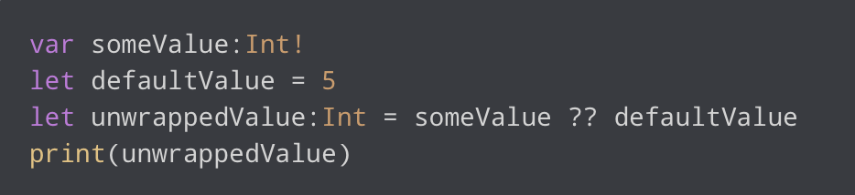
Nil-coalescing operator
In Swift, you can also use nil-coalescing operator to check whether a optional contains a value or not.
It is defined as (a ?? b).
It unwraps an optional a and returns it if it contains a value, or returns a default value b if a is nil.

Slide 25
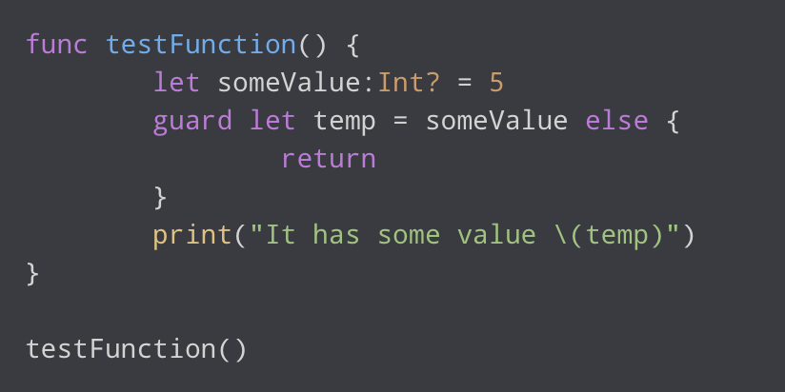
Guard statement
For now, just think of guard as an if-else condition with no if block.
If the condition fails, else statement is executed. If not, next statement is executed.
In given example, the guard contains a condition whether an optional someValue contains a value or not. If it contains a value then guard-let statement automatically unwraps the value and places the unwrapped value in temp constant. Otherwise, else block gets executed and and it would return to the calling function.
OUTPUT: It has some value 5

Slide 26
Using Guard Statement with Optionals
The guard statement in Swift is used to safely unwrap optionals.
It allows you to check for a condition and if that condition isn’t met, it exits the current scope, preventing the optional from being unwrapped.
func processData(data: Data?)
{
guard let data else {
print("No data found")
return
}
// process the data
}

Slide 27
Using Multiple Guard Statements
You can also use multiple guard statements for multiple optionals in the same scope. This can make your code more readable.
func processData(data: Data?, metadata: Metadata?)
{ guard let data else
{
print("No data found")
return
}
guard let metadata else
{
print("No metadata found")
return }
// process the data and metadata
}
Notes:
This way, if the first optional isn’t present, the second guard statement won’t be executed.

Slide 28
Using Guard Statement with Optionals
In this example,
the guard statement checks if the data variable is not nil.
If data is nil, the guard statement triggers the else block and the function exits, preventing the code inside the function from executing.
If data is not nil, the optional is unwrapped and the code inside the function continues to execute.

Slide 29

Unit 3, Lesson 1
Lab: Optionals.playground
Open and complete the exercises in Lab - Optionals.playground

Slide 30
Notes:
L569805A-en_WW App Development with Swift © 2021 Apple Inc. This work is licensed by Apple Inc. under the Creative Commons Attribution-NonCommercial-ShareAlike 4.0 International license (https://creativecommons.org/licenses/by-nc-sa/4.0/legalcode).

